Slide 1

When Dumbness Turns Dangerous
- Prason Pandey
https://prasonpandey.com.np

Slide 2

Prason Pandey
DevSecOps Engineer
@Reduct Nepal
itsprason@gmail.com

Slide 3
This is a Story.

Slide 4
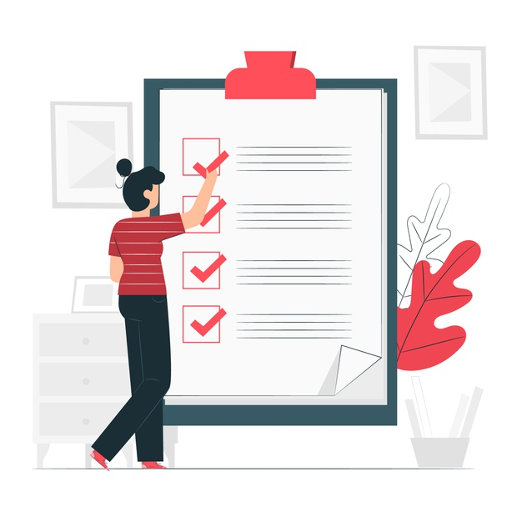
Topics
Discovering the API Key
Extracting Sensitive Information
Attacking API Provider
Reporting Vulnerabilities
Filing a Formal Complaint
Key Takeaways and Lessons Learned

Slide 5
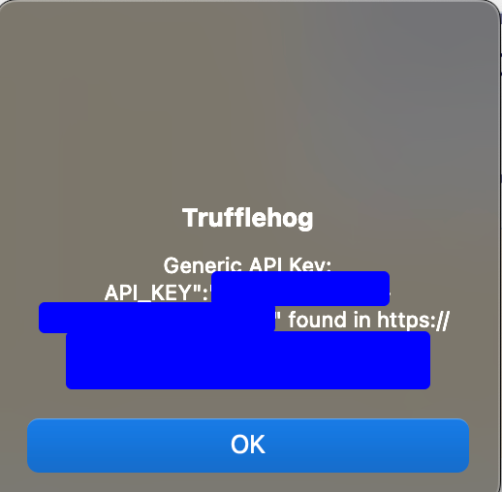
API Key
Found API key with the help of Trufflehog in the client’s website.

Slide 6

TruffleHog
Find leaked credentials.
Identify, Prevent & Remediate secret leaks across all the platforms.
Web Source Code, Github, Gitlab, Docker, S3, etc

Slide 7
API Provider

Slide 8
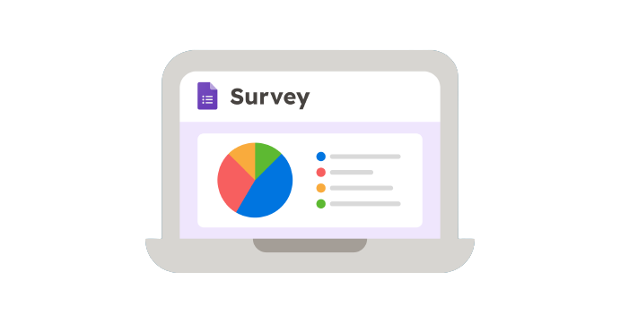
API Provider
Enterprise Survey Management Platform.
Provides Forms & Survey Management Service.

Slide 9
Documentation

Slide 10
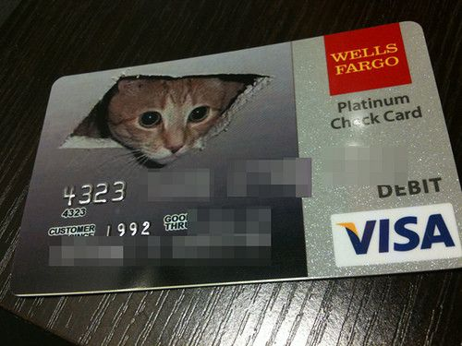
GET /get-user
Comprehensive Access to Account Owner Details
Read-Only Permission Granted
Access to Name, Email, Account Status, Billing Info, etc.

Slide 11
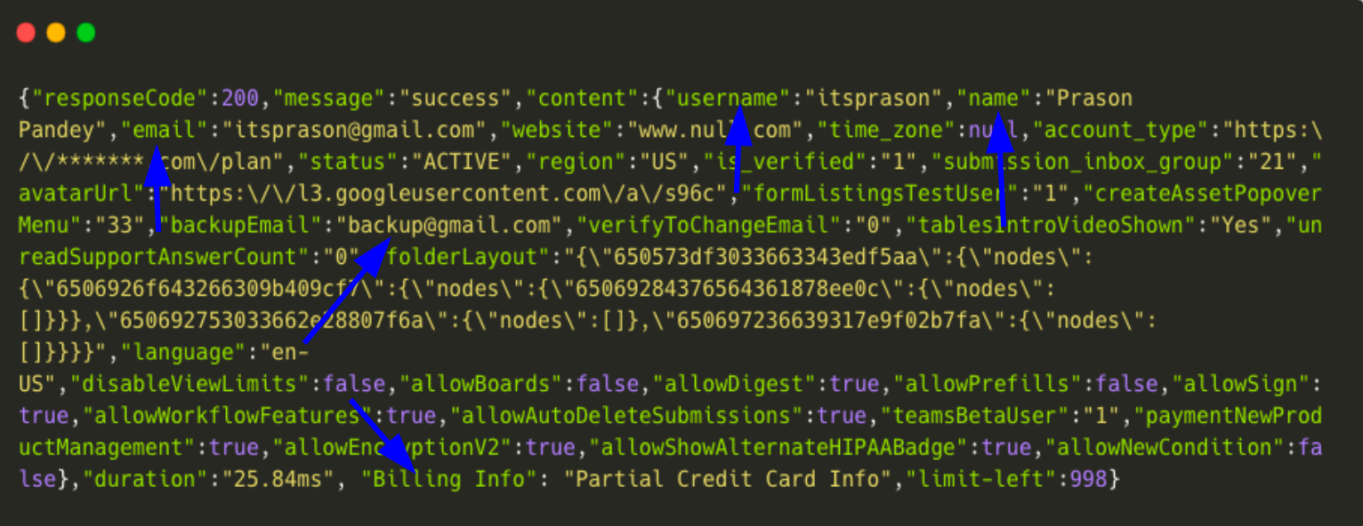

Slide 12
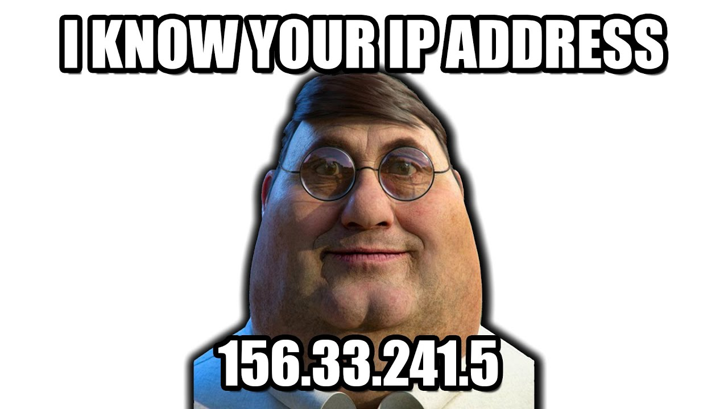
GET /submissions
Full Access to Survey Submissions Data
Including Form Submissions and IP Addresses

Slide 13
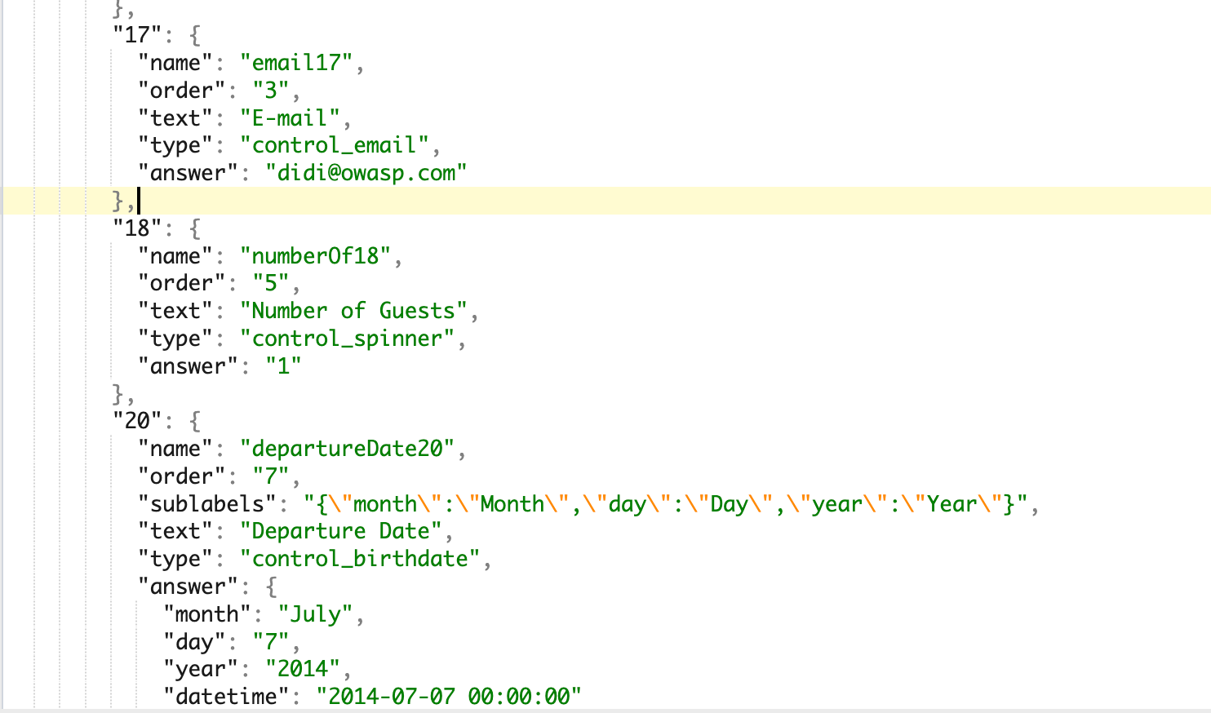

Slide 14

GET /reports
Listing Reports with URLs
Admin Access Required for Download

Slide 15
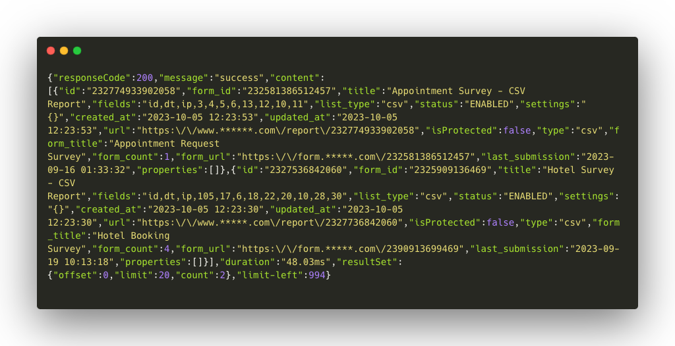

Slide 16
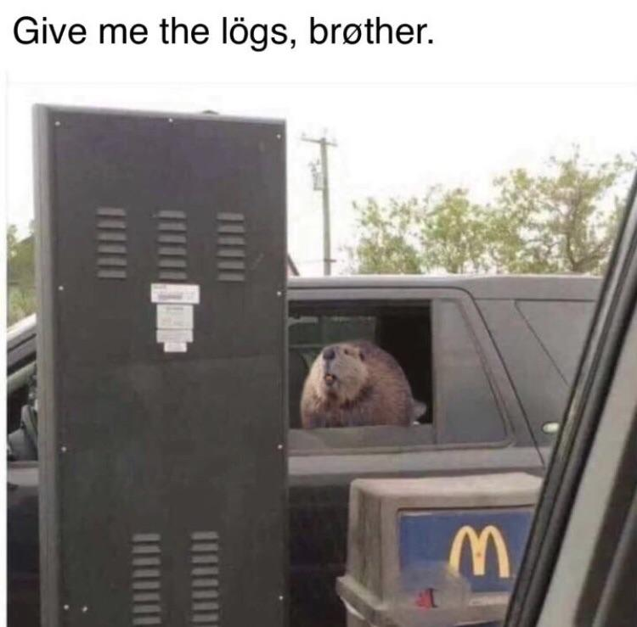
GET /logs
Full Access to Activity Logs
Viewing Activity, User, and IP Address Logs.

Slide 17
Attacking API

Slide 18
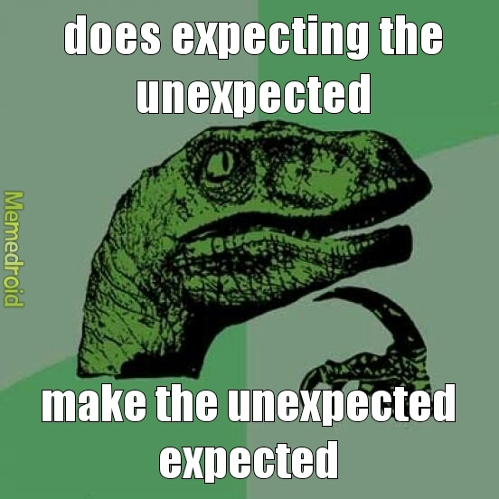
POST & PUT /something
Surprising Write Access on Certain Endpoints
Able to Modify Company Info, Form Details, and Fields

Slide 19

DELETE /report
DELETE Method was Accepted
Deletion of Reports without Authentication Allowed

Slide 20

Stealing Your Account
Modified Backup Email Address Successfully
Reset Account Using Backup Email Address

Slide 21
Reporting Vulnerability

Slide 22
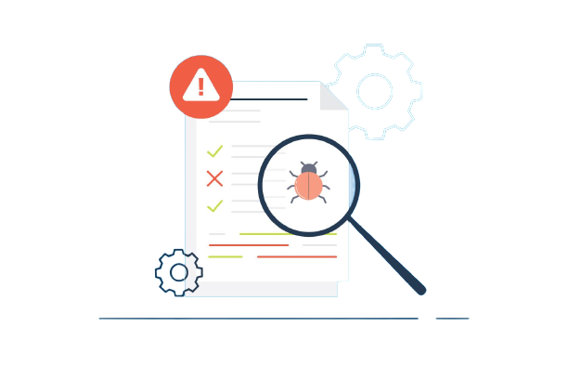
Reporting
Reported Issues to the API Provider
Utilized a Vulnerability Disclosure Program
Received No Response
Multiple Follow-ups

Slide 23
GDPR

Slide 24
GDPR
Filed GDPR Complaint
GDPR Empowers Users to Control Their Data
Non-Compliance Can Result in Significant Financial Penalties

Slide 25
Afterward
Vulnerabilities resolved within a few weeks
GDPR intervention was essential
Charges are yet not confirmed to us

Slide 26
Takeaways

Slide 27

Something To Learn
Third-party APIs Can Lead to Data Breaches
Security Should Never Be Ignored
Compliance Matters
Quality Assurance (QA) is Essential

Slide 28
Security is not about the things we trust; it's about the things we don't. Third-party APIs are no exception.

Slide 29
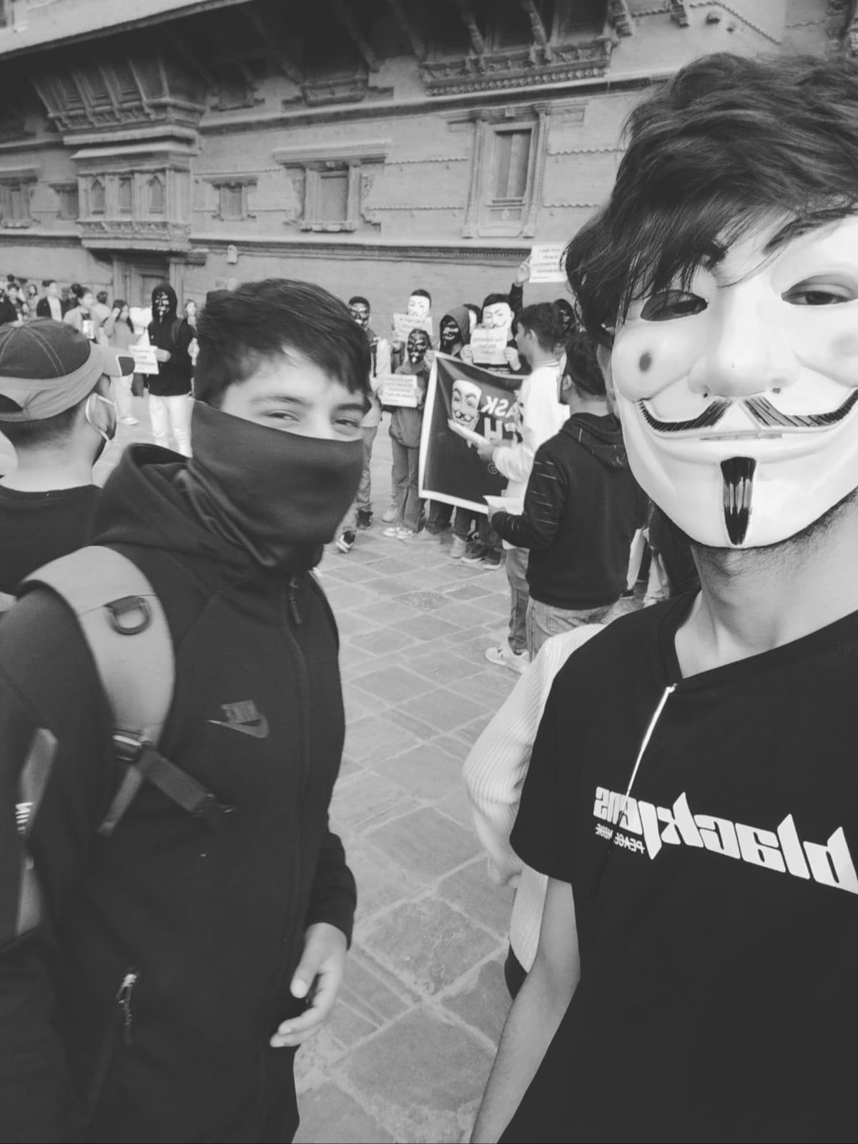
Gratitude to My Guiding Light
Thank you for your invaluable guidance and support on this journey
Your mentorship has been instrumental in getting me to where I am today
TheNittam X TheCrysp

Slide 30
Connect Me On
https://www.linkedin.com/in/itsprason
https://twitter.com/TheCaffeineNerd

Slide 31
Hack The APIs.

